Slide 1
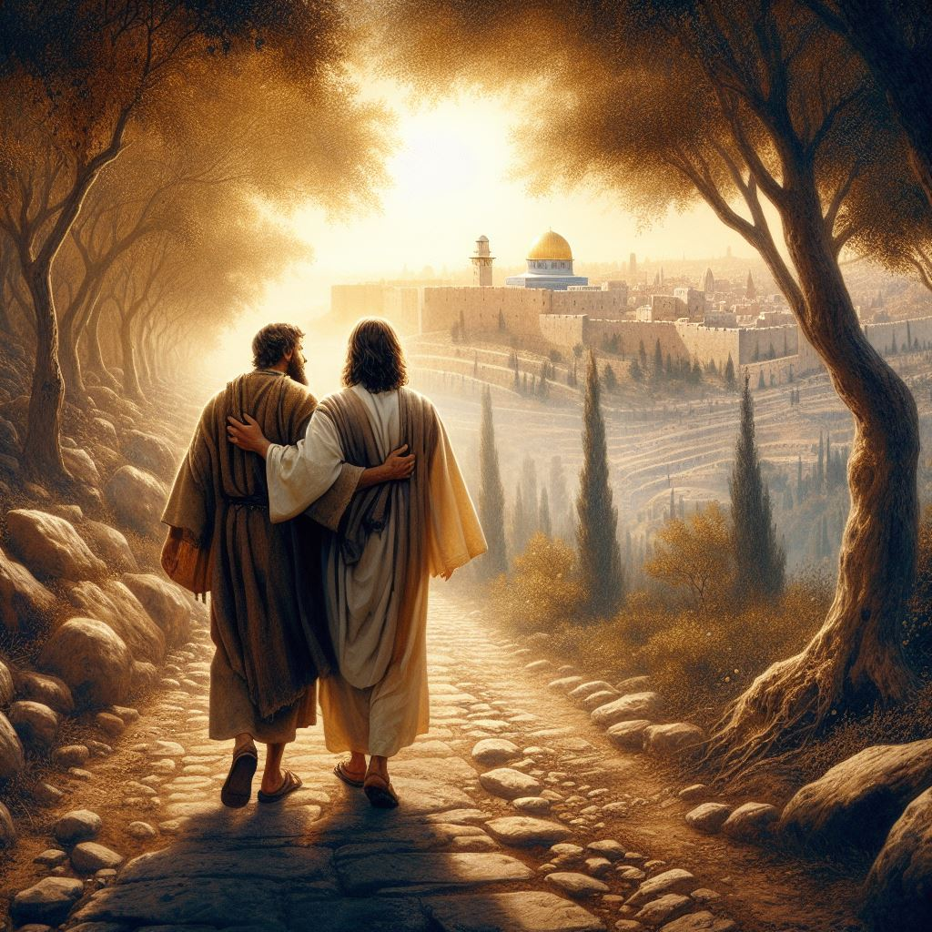
Embracing a Jesus-Centered Life:
A Call to Faith, Service, and Transformation

Slide 2
Today, we reflect on the profound significance of living a Jesus-centered life. It is in our unwavering surrender, faith, and commitment to Christ that we find true purpose, abundant blessings, and transformative power. As we meditate on the teachings of Jesus, let us renew our dedication to walking in the footsteps of our Savior and spreading His light in the world.

Slide 3
Billy Graham once wisely remarked,
"God has given us two hands - one to receive with and the other to give with."
This poignant statement reminds us of the dual nature of our Christian calling - to receive the boundless love and grace of God with gratitude, and to extend that same love and grace to others through acts of service and compassion. Living a Jesus-centered life compels us to be vessels of God's love, sharing His message of redemption and hope with all whom we encounter.

Slide 4
Truth is love, and absolutely necessary in these times!
In the church:
In Ephesians 4:15-16 (ESV), the apostle Paul writes about the importance of how believers are to communicate and interact with one another within the context of the Christian community.
“15 Rather, speaking the truth in love, we are to grow up in every way into him who is the head, into Christ, 16 from whom the whole body, joined and held together by every joint with which it is equipped, when each part is working properly, makes the body grow so that it builds itself up in love.

Slide 5
The verse emphasizes the balance between speaking the truth and doing so in a spirit of love and compassion. By speaking the truth with love, believers are encouraged to grow and mature in their faith, aligning themselves more closely with the teachings and character of Christ, who is described as the head of the church.
This verse highlights the idea that truth and love are not mutually exclusive but rather complementary aspects of Christian life. It underscores the importance of both upholding the truth of the Gospel and demonstrating love and grace in our interactions with others. This balance is essential for fostering unity, spiritual growth, and building a strong and healthy community of believers who reflect the character of Christ in all they do.

Slide 6
In the world:
1 Peter 3:15-16 ESV
"But in your hearts honor Christ the Lord as holy, always being prepared to make a defense to anyone who asks you for a reason for the hope that is in you; yet do it with gentleness and respect, having a good conscience, so that, when you are slandered, those who revile your good behavior in Christ may be put to shame."

Slide 7
This passage encourages believers to be ready to give a defense or explanation for their faith and hope in Christ when asked by others. It emphasizes the importance of doing so with gentleness, respect, and a clear conscience.
By maintaining good behavior and responding graciously, even in the face of slander or criticism, believers can reflect the character of Christ and potentially lead others to shame those who speak against them unjustly.

Slide 8
The reason we fight:
how truth can defeat sin based on scripture: 1. John 8:32 - "And you will know the truth, and the truth will set you free.“
This verse from the Gospel of John highlights the liberating power of truth. When we come to know and embrace the truth of God's Word, it can set us free from the bondage of sin. The truth reveals our need for a Savior and points us to the redemptive work of Jesus Christ, who conquered sin and death on the cross.

Slide 9
2. 1 John 1:8 –
"If we say we have no sin, we deceive ourselves, and the truth is not in us.“
This verse from the First Epistle of John reminds us of the importance of acknowledging our sinfulness. When we try to deny or ignore our sin, we deceive ourselves and distance ourselves from the truth. However, when we humbly confess our sins and seek forgiveness, the truth of God's grace and mercy can work in our lives to bring about transformation and healing.

Slide 10
3. Ephesians 6:14 –
"Stand therefore, having fastened on the belt of truth, and having put on the breastplate of righteousness,“
In his letter to the Ephesians, the apostle Paul uses the imagery of a soldier's armor to illustrate the spiritual battle that believers face. The "belt of truth" represents the foundational truth of God's Word, which holds everything together. By putting on the armor of God, including the belt of truth, we are equipped to stand firm against the schemes of the enemy and resist the temptations of sin.

Slide 11
4. Psalm 86:11 –
"Teach me your way, O Lord, that I may walk in your truth; unite my heart to fear your name.“
This psalm of David expresses a desire to walk in God's truth and to be aligned with His ways. When we seek to follow God's truth and obey His commands, our hearts are transformed, and we develop a reverence for His name. It is through a commitment to living in God's truth that we can experience victory over sin and grow in our relationship with Him.

Slide 12
The apostle Paul played a significant role in undermining the worship of Diana (or Artemis) in Ephesus, as described in the New Testament in the book of Acts, Chapter 19. According to the biblical account, Paul's preaching and teaching in Ephesus led to a decrease in the worship of Diana, who was a popular goddess in the city and had a huge temple dedicated to her. Paul's message about the one true God and his teachings about Jesus Christ challenged the beliefs and practices associated with the cult of Diana.

Slide 13
This caused a stir among the silversmiths and craftsmen who made their living by creating and selling silver shrines of Diana. When they saw that Paul's teachings were affecting their business and the popularity of the cult of Diana, they stirred up a riot in the city. The rioters seized two of Paul's companions and caused a commotion in the city. Eventually, the city clerk intervened and calmed the crowd, pointing out that Paul and his companions had not blasphemed the goddess Diana and that there were legal ways to address their concerns. This incident is often cited as an example of how Paul's preaching and teaching had an impact on the worship of Diana in Ephesus.

Slide 14
The truth of God's Word has the power to overcome sin. By embracing the truth, acknowledging our sinfulness (Humility), putting on the armor of God (Faith), and seeking to walk in His ways (obedience), we can experience freedom, transformation, and victory over sin.

Slide 15
In the Bible, specifically in the book of Romans, the Apostle Paul references performing signs and wonders through the power of the Holy Spirit.
In Romans 15:18-19 (ESV), Paul says:
"For I will not venture to speak of anything except what Christ has accomplished through me to bring the Gentiles to obedience—by word and deed, by the power of signs and wonders, by the power of the Spirit of God—so that from Jerusalem and all the way around to Illyricum I have fulfilled the ministry of the gospel of Christ.“
This passage highlights Paul's ministry and how he relied not only on words but also on the demonstration of the power of the Holy Spirit through signs and wonders to bring people to faith in Christ.

Slide 16
Invoking His Name is invoking His Presence and Power:
In Colossians 3:17(ESV) the apostle Paul exhorts us,
"And whatever you do, in word or deed, do everything in the name of the Lord Jesus, giving thanks to God the Father through him."
These words serve as a guiding principle for our lives, challenging us to align every aspect of our being with the will of Christ. When we live with a consciousness of Jesus at the center of all we do, our words and actions become a testimony to His transformative power and unending grace.

Slide 17
In ancient Hebrew culture and religious thought, "The Name" often referred to the name of God, which was considered sacred and not to be spoken casually. The name of God was believed to embody His essence, power, and authority. In the Hebrew Bible (Old Testament), the name of God is often represented by “YHWH”, which is sometimes vocalized as Yahweh or Jehovah.

Slide 18
Ancient Hebrew writers and scribes treated the name of God with great reverence and respect. They believed that invoking the name of God had significant spiritual and religious implications. The Third Commandment in the Hebrew Bible prohibits taking the name of the Lord in vain, emphasizing the sanctity of God's name and the importance of our submission to Him. Overall, ancient Hebrew writers interpreted "The Name" as a direct connection to the divine, representing the presence, power, and holiness of God in their lives and in the world.

Slide 19
Not our power, but our obedience:
In the Gospel of Matthew 6:33 (ESV) Jesus Himself instructs us,
"But seek first the kingdom of God and his righteousness, and all these things will be added to you."
This verse underscores the importance of prioritizing our relationship with God above all earthly concerns. When we make Jesus the focal point of our lives, we can trust in His provision, guidance, and abundant blessings to sustain us on our journey of faith. The Glorification of Jesus in our lives manifests blessings.

Slide 20
One Bible verse that speaks to this truth is Ephesians 3:20-21 (ESV): "Now to him who is able to do far more abundantly than all that we ask or think, according to the power at work within us, to him be glory in the church and in Christ Jesus throughout all generations, forever and ever. Amen." This verse emphasizes that God is able to do exceedingly abundantly above all that we can ask or think, and it is through His power that these blessings come to us. The ultimate purpose of these blessings is to bring glory to God in the church and in Christ Jesus throughout all generations.

Slide 21
One verse that speaks to the idea of God glorifying Himself through believers is found in
1 Peter 4:11 (ESV) "whoever speaks, as one who speaks oracles of God; whoever serves, as one who serves by the strength that God supplies—in order that in everything God may be glorified through Jesus Christ. To him belong glory and dominion forever and ever. Amen." This verse emphasizes that believers should speak and serve. They should do so in a way that brings glory to God through Jesus Christ. It highlights the idea that our words and actions can reflect God's glory and can point others to Him.

Slide 22
Billy Graham's also said,
"The will of God will not take us where the grace of God cannot sustain us."
In moments of trial, temptation, and uncertainty, we can take refuge in the unchanging grace and strength of our Lord. When we anchor our lives in Christ and walk in obedience to His teachings, we can rest assured that His grace will uphold us and carry us through every season of life.

Slide 23
What impurities will surface when we are tested in the furnace of this world?
Andrew Murray, a revered theologian and author, delved deeply into the theme of humility in the pursuit of holiness. He eloquently expressed, "The great test of whether the holiness we profess to seek or to attain is truth and life will be whether it produces an increasing humility in us." Humility, as exemplified by Jesus Himself, is the cornerstone of a Jesus-centered life. It is through humility that we acknowledge our utter dependence on God and surrender our will to His divine purpose, allowing His grace to work in and through us.

Slide 24
Let us commit ourselves wholeheartedly to embracing a Jesus-centered life, where every thought, word, and deed is a reflection of His love and truth. May we be vessels of His light in a world shrouded in darkness, shining brightly with the hope and salvation found in Christ alone.
In closing, let us pray for the courage, wisdom, and faith to live out our calling as followers of Jesus, spreading His message of love and redemption to all we encounter, and taking every opportunity to give of ourselves and serve all those in need, that our Father has placed in our path. May our lives be a living testimony to the transformative power of a faith centered on Christ, and may we be instruments of His peace and grace in a world in need of His saving love.

