Slide 1
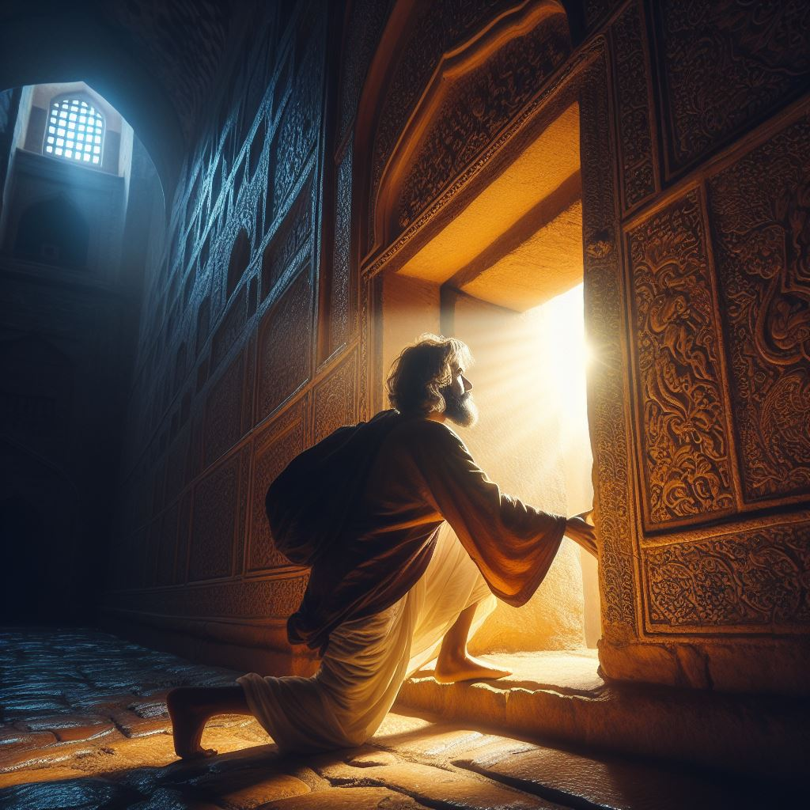
The Transformative Journey of Humility and Faith:
The necessary posture to enter God’s kind of Faith.

Slide 2
Introduction:
Today we come together to explore the profound and intricate relationship between humility and the kind of faith that is pleasing to our Heavenly Father. In a world that often prioritizes self-promotion and self-reliance, it is crucial for us to understand the deep significance of humility in shaping our faith and our walk with God. Let us take a closer look through the Word of God to uncover the profound truths that lie at the intersection of humility and faith.
James 4:6 (ESV)
"But he gives more grace. Therefore, it says, 'God opposes the proud but gives grace to the humble.'"

Slide 3
The Foundation of Humility: A Heart Postured Towards God
Humility serves as the cornerstone of our relationship with God, reflecting a heart that is surrendered and submissive to His will. As Proverbs 3:34 (ESV) reminds us, "Toward the scorners he is scornful, but to the humble he gives favor." When we humble ourselves before God, we acknowledge our need for His guidance and grace, inviting His transformative power into our lives.
Micah 6:8 (ESV)
"He has told you, O man, what is good; and what does the Lord require of you but to do justice, and to love kindness, and to walk humbly with your God?"

Slide 4
The Sacred Dance of Humility and God's Faith:
Humility and faith dance together in a sacred union, each nourishing and strengthening the other. In Matthew 18:4 (ESV), Jesus teaches, "Whoever humbles himself like this child is the greatest in the kingdom of heaven." Just as a child trusts their parent completely, so must we trust in God with childlike faith, surrendering our doubts and fears at His feet.
Hebrews 11:1 (ESV)
"Now faith is the assurance of things hoped for, the conviction of things not seen."

Slide 5
The desire of God’s Heart:
Faith is the essence of our relationship with our father. It is our outward, physical display of our love, obedience and submission to him, and results in him manifesting his glory through us.
Hebrews 11:5-6 (ESV)
5 By faith Enoch was taken up so that he should not see death, and he was not found, because God had taken him. Now before he was taken, he was commended as having pleased God. 6 And without faith it is impossible to please him, for whoever would draw near to God must believe that he exists and that he rewards those who seek him.

Slide 6
Living Out Humility and Nurturing God's Faith:
Practicing humility and nurturing God's kind of faith is a lifelong journey that requires intentionality and steadfast commitment. In Colossians 3:12-13 (ESV), we are exhorted to "Put on then, as God's chosen ones, holy and beloved, compassionate hearts, kindness, humility, meekness, and patience, bearing with one another and, if one has a complaint against another, forgiving each other; as the Lord has forgiven you, so you also must forgive."
1 Peter 5:6 (ESV)
"Humble yourselves, therefore, under the mighty hand of God so that at the proper time he may exalt you."

Slide 7
Conclusion:
Let us commit to cultivating a spirit of humility and a faith that pleases our Heavenly Father. May we embrace humility as a virtue that draws us closer to God's heart and anchors our faith in His unchanging promises. Let us go forth from this place, empowered by humility and faith, to be ambassadors of God's love and grace in a world that longs for the transformative power of His presence!

