Slide 1
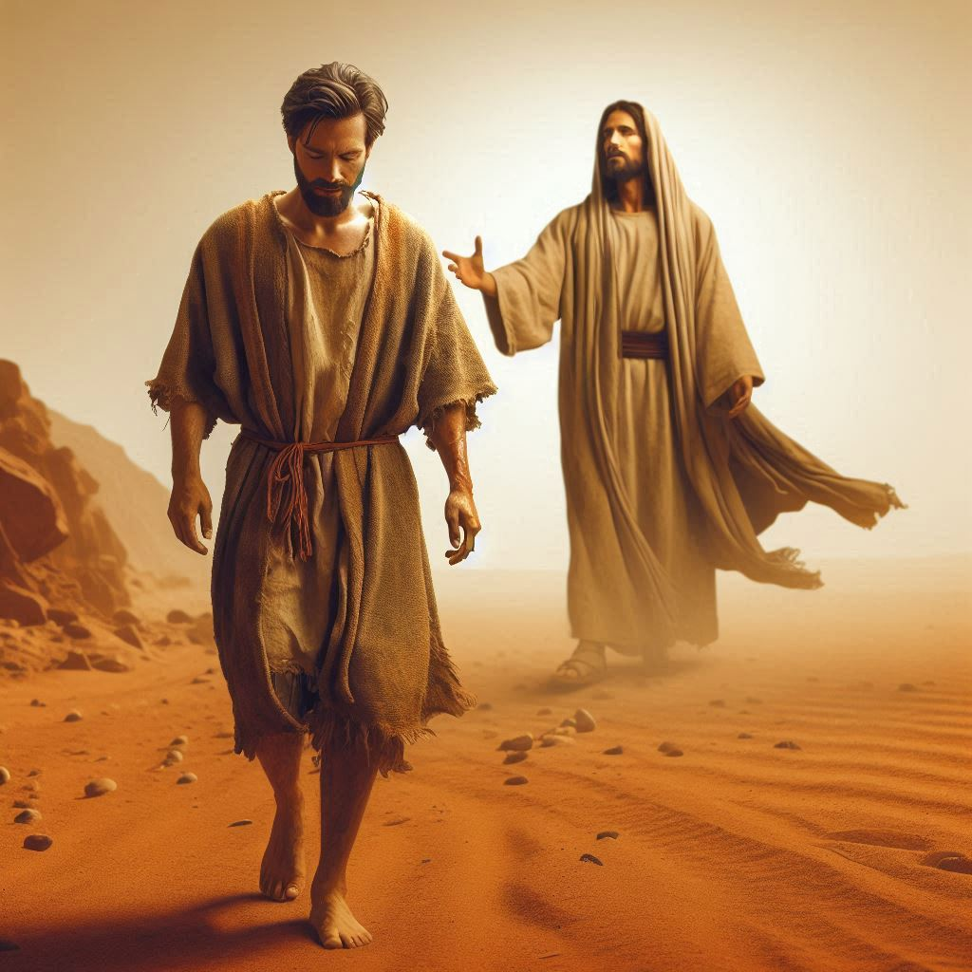
Are you living for Jesus, or are you living WITH Jesus? Part Two
The importance of knowing the Presence of God

Slide 2
In Review:
- In these end times, many Christians are looking for the return of Jesus in the physical as if he is not already here. Instead, we should be focusing on his presence with us now.
Many Christians fall into the trap of waiting to receive what we already have.
We are to live with Jesus now in the physical realm (already), and in the Kingdom, the spiritual realm that is to come (not yet).
- This span between these two is the eternal life that Jesus describes in his prayer to our father in the garden of Gethsemane. (John 17:1-3)

Slide 3
In Review:
These are the instructions for “now”. Living with Jesus and as Jesus lives daily.
- God's will is his desire of his heart.
- Warn and reprimand against idols.
- Be an encourager.
- Be a helper.
- Be patient.
- Prevent and do not participate in vengeance.
- Be a doer of good to everyone.
- Rejoice always.
- Pray constantly. Talk to Jesus as if he were with you, because he is all the time.
- Give thanks in the midst of every circumstance.
Abstain from all evil.
What we are instructed not to do:
- Do not allow apathy, logic or denial to quench the Holy Spirit.
- Do not mistrust all prophecy but test it with the word of God and the Holy Spirit.

Slide 4
In Review:
The traps of pride:
Having our minds centered on the physical and ourselves.
Not being familiar with the presence of God.
Allowing selfishness to supersede our understanding of the power of God.
Using our own wisdom instead of obedience.
Allowing our efforts to supersede obedience, and our submission in listening to him.
He considers this rebellion, and it is the same as witchcraft. This manifests in false prophecy and attempting to predict the movements of God and obtain the power of God Using our own wisdom.

Slide 5
In Review:
The traps of pride:
To ignore God's word is to reject it. God will resist the proud.
What we don't know will kill us.
Pride will create obstacles to God's plan.
Pride advances Satan’s plan in our lives and the world.
- Change comes from the inside out (our heart). This happens both for good and for evil and is part of the framework that God built in us.

Slide 6
In Review:
He isn't our Lord if we disobey.
We reap what we sow. It is really that simple.
- We cannot blame God for things we were disobedient with.

Slide 7
Humility is the door to faith being active in our lives:
- Humility equals pleasing God.
- We must speak openly with truth to lies.
- The only truth is truth that comes from God.
- God's truth is only to glorify him and lifts up Jesus.
- This is why Satan hates truth and is the master of all lies.

Slide 8
2 Corinthians 4:1-6, 16-18
4 Therefore, having this ministry by the mercy of God,[a] we do not lose heart. 2 But we have renounced disgraceful, underhanded ways. We refuse to practice[b] cunning or to tamper with God's word, but by the open statement of the truth we would commend ourselves to everyone's conscience in the sight of God. 3 And even if our gospel is veiled, it is veiled to those who are perishing. 4 In their case the god of this world has blinded the minds of the unbelievers, to keep them from seeing the light of the gospel of the glory of Christ, who is the image of God. 5 For what we proclaim is not ourselves, but Jesus Christ as Lord, with ourselves as your servants[c] for Jesus' sake. 6 For God, who said, “Let light shine out of darkness,” has shone in our hearts to give the light of the knowledge of the glory of God in the face of Jesus Christ.

Slide 9
16 So we do not lose heart. Though our outer self[d] is wasting away, our inner self is being renewed day by day. 17 For this light momentary affliction is preparing for us an eternal weight of glory beyond all comparison, 18 as we look not to the things that are seen but to the things that are unseen. For the things that are seen are transient, but the things that are unseen are eternal.
- We are to focus on the Kingdom, not the world.
- Grace was given so that faith may abound, and God be glorified.

Slide 10
Philippians 2:1-13
Christ's Example of Humility
2 So if there is any encouragement in Christ, any comfort from love, any participation in the Spirit, any affection and sympathy, 2 complete my joy by being of the same mind, having the same love, being in full accord and of one mind. 3 Do nothing from selfish ambition or conceit, but in humility count others more significant than yourselves. 4 Let each of you look not only to his own interests, but also to the interests of others. 5 Have this mind among yourselves, which is yours in Christ Jesus,[a] 6 who, though he was in the form of God, did not count equality with God a thing to be grasped,[b] 7 but emptied himself, by taking the form of a servant,[c] being born in the likeness of men. 8 And being found in human form, he humbled himself by becoming obedient to the point of death, even death on a cross. 9 Therefore God has highly exalted him and bestowed on him the name that is above every name, 10 so that at the name of Jesus every knee should bow, in heaven and on earth and under the earth, 11 and every tongue confess that Jesus Christ is Lord, to the glory of God the Father.

Slide 11
- Being of the same mind, same love, and same accord is just as important has been encouraging, showing loving comfort, and participating in the Holy Spirit.
- Humility will manifest selflessness.
- One cannot serve God and before of oneself.
- Humility is dying to oneself daily and dying for the will of God.
- Humility reveals the purpose of our lives, which is to glorify God.

Slide 12
Lights in the World
12 Therefore, my beloved, as you have always obeyed, so now, not only as in my presence but much more in my absence, work out your own salvation with fear and trembling, 13 for it is God who works in you, both to will and to work for his good pleasure.
Working out salvation with fear and trembling is to only live in a way that requires faith.
- Faith is God working in us, both for his will and to please him.

Slide 13
Romans 6:15-23
Slaves to Righteousness
15 What then? Are we to sin because we are not under law but under grace? By no means! 16 Do you not know that if you present yourselves to anyone as obedient slaves, you are slaves of the one whom you obey, either of sin, which leads to death, or of obedience, which leads to righteousness? 17 But thanks be to God, that you who were once slaves of sin have become obedient from the heart to the standard of teaching to which you were committed, 18 and, having been set free from sin, have become slaves of righteousness. 19 I am speaking in human terms, because of your natural limitations. For just as you once presented your members as slaves to impurity and to lawlessness leading to more lawlessness, so now present your members as slaves to righteousness leading to sanctification. 20 For when you were slaves of sin, you were free in regard to righteousness. 21 But what fruit were you getting at that time from the things of which you are now ashamed? For the end of those things is death. 22 But now that you have been set free from sin and have become slaves of God, the fruit you get leads to sanctification and its end, eternal life. 23 For the wages of sin is death, but the free gift of God is eternal life in Christ Jesus our Lord.

Slide 14
- We are servants to what we give our hearts to.
- Our wisdom/ logic comes from the mind, but obedience comes from the heart.
- We can give our hearts to righteousness or to death.
- Our logic/ minds are limited, and our understanding is less than God's wisdom.
- Our hearts devoted to Godly wisdom will bring us into sanctification (holiness).
- Sin has a cost, but grace is free and a gift.

Slide 15
Hebrews 6:1-12
1Therefore let us leave the elementary doctrine of Christ and go on to maturity, not laying again a foundation of repentance from dead works and of faith toward God, 2and of instruction about washings, and the laying on of hands, the resurrection of the dead, and eternal judgment. 3And this we will do if God permits. 4For it is impossible, in the case of those who have once been enlightened, who have tasted the heavenly gift, and have shared in the Holy Spirit, 5and have tasted the goodness of the word of God and the powers of the age to come, 6and then have fallen away, to restore them again to repentance, since they are crucifying once again the Son of God to their own harm and holding him up to contempt. 7 For land that has drunk the rain that often falls on it and produces a crop useful to those for whose sake it is cultivated, receives a blessing from God. 8 But if it bears thorns and thistles, it is worthless and near to being cursed, and its end is to be burned.
9 Though we speak in this way, yet in your case, beloved, we feel sure of better things—things that belong to salvation. 10 For God is not unjust so as to overlook your work and the love that you have shown for his name in serving the saints, as you still do. 11And we desire each one of you to show the same earnestness to have the full assurance of hope until the end, 12so that you may not be sluggish, but imitators of those who through faith and patience inherit the promises.

Slide 16
- This passage is written not about Christians but about unbelievers who are convinced of the basic truths of the gospel but who have not placed their faith in Jesus Christ as Savior. They are intellectually persuaded but spiritually uncommitted.

Slide 17
- The phrase once enlightened (Hebrews 6:4) refers to some level of instruction in biblical truth. However, understanding the words of Scripture is not the same as being regenerated by the Holy Spirit. For example, John 1:9 describes Jesus, the “true Light,” giving light “to every man”; but this cannot mean the light of salvation, because not every man is saved. Through God’s sovereign power, every man has enough light to be held responsible. This light either leads to the complete acceptance of Jesus Christ or produces condemnation in those who reject such light. The people described in Hebrews 6:4–6 is of the latter group—unbelievers who have been exposed to God’s redemptive truth and perhaps have made a profession of faith, but who have not exercised genuine saving faith.

Slide 18
- This also sees the phrase tasted the heavenly gift (Hebrews 6:4) as referring to a momentary experience, akin to Jesus’ “tasting” death (Hebrews 2:9). This brief experience with the heavenly gift is not seen as equivalent to salvation; rather, it is likened to the second and third soils in Jesus’ parable (Matthew 13:3–23), which describes people who receive the truth of the gospel but are not truly saved.

Slide 19
- Finally, the “falling away” (Hebrews 6:6) as a reference to those who have tasted the truth but, not having come all the way to faith, fall away from even the revelation they have been given. The tasting of truth is not enough to keep them from falling away from it. They must come all the way to Christ in complete repentance and faith; otherwise, they in effect re-crucify Christ and treat Him contemptuously. Those who sin against Christ in such a way have no hope of restoration or forgiveness because they reject Him with full knowledge and conscious experience. They have concluded that Jesus should have been crucified, and they stand with His enemies. It is impossible to renew such to repentance.

