Slide 1
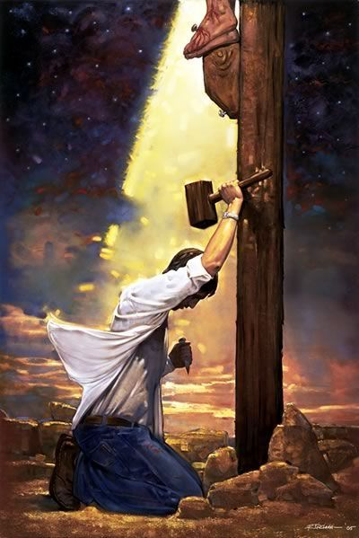

Love driven Devotion
Spiritual priorities in action

