Slide 1
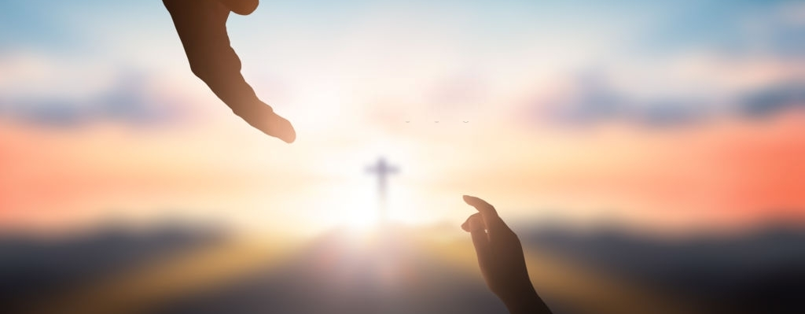
FORGIVENESS
CHANGING THE HEARTS AND MINDS OF THE WORLD

