Slide 1
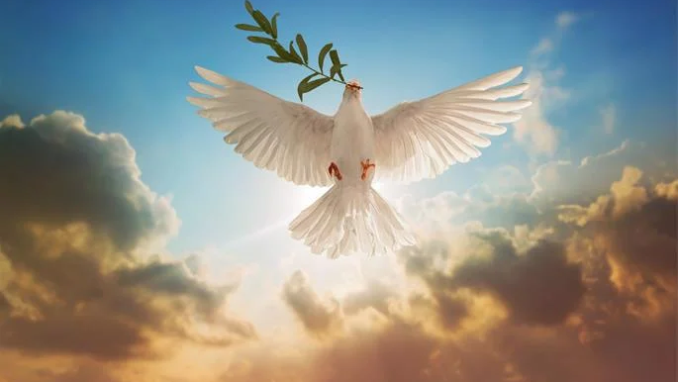
Blessed are the peacemakers
The 7 steps to finding Peace and becoming a Peacemaker

