Slide 1
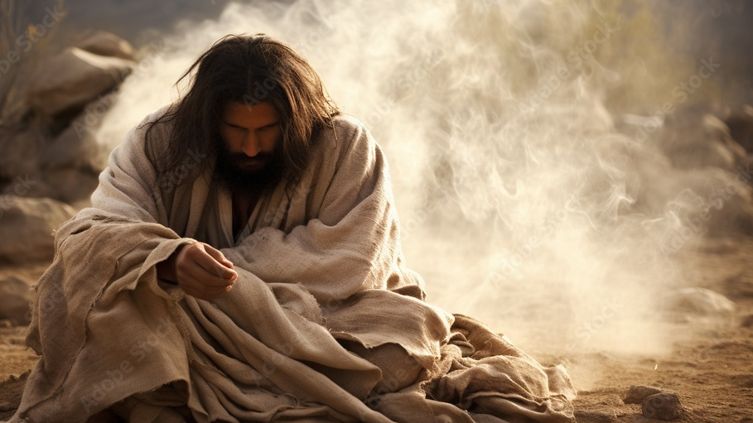
Grief the results of corruption
And a call to rescue

