Slide 1
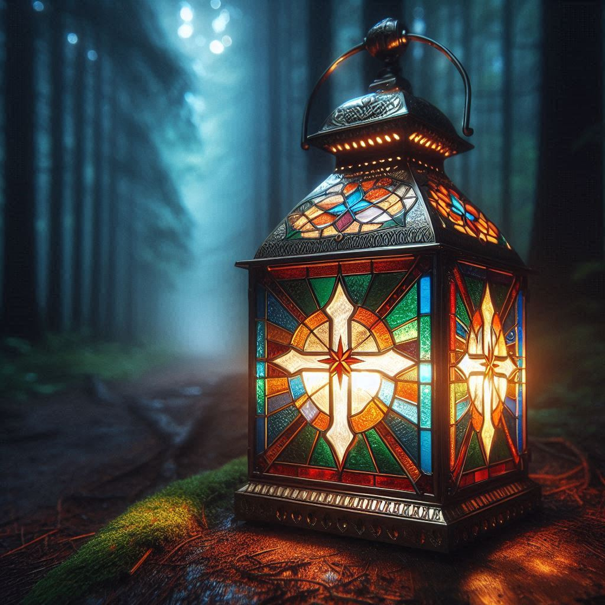
Lighting the path to the temple
The Kingdom of Heaven is at hand

