Slide 1
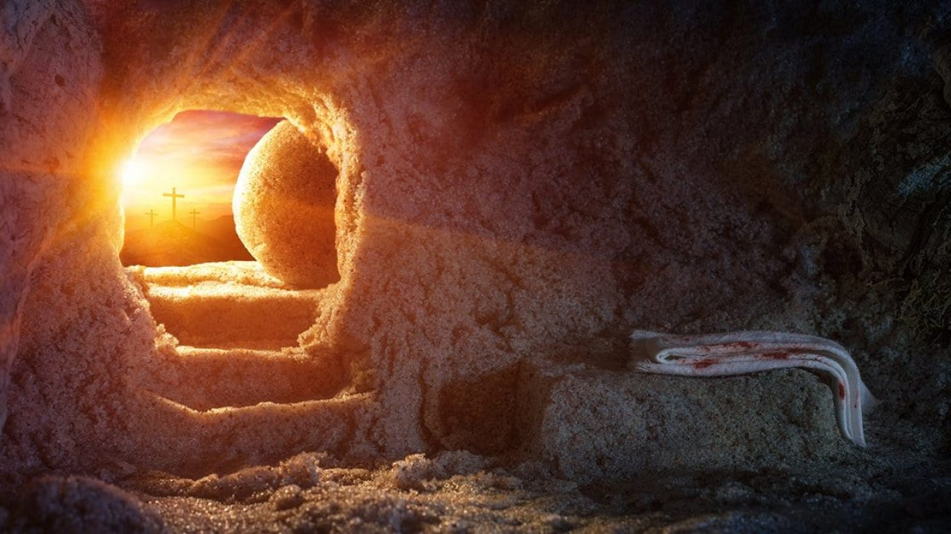
the beginning of hope
The first fruits of new creation

